Slide 1
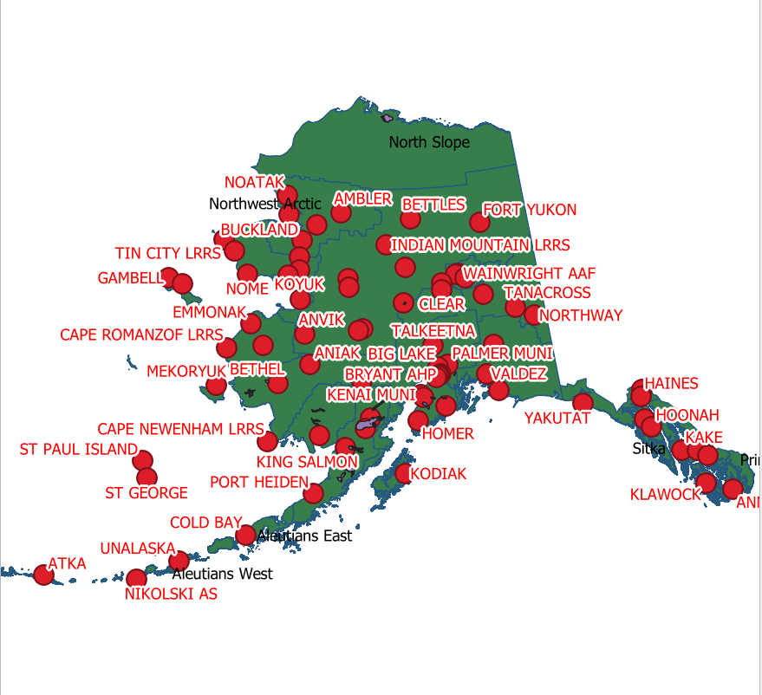
A brief introduction to Full-featured GIS Software
DARIAH-DE WORKSHOP September 2019 Monika Barget

Slide 2



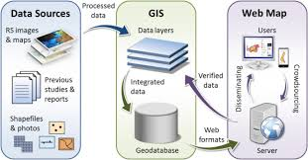
FULL-FEATURED GIS SOFTWARE
Geo-information ingested into GIS software comes from databases and/or collections of raster data and shapesfiles collected in a file repository!
IMPORTANT: GIS software displays geo-data and adds refined visual features (colours, patterns, symbols), but it does not store the actual geographic information!

Slide 3
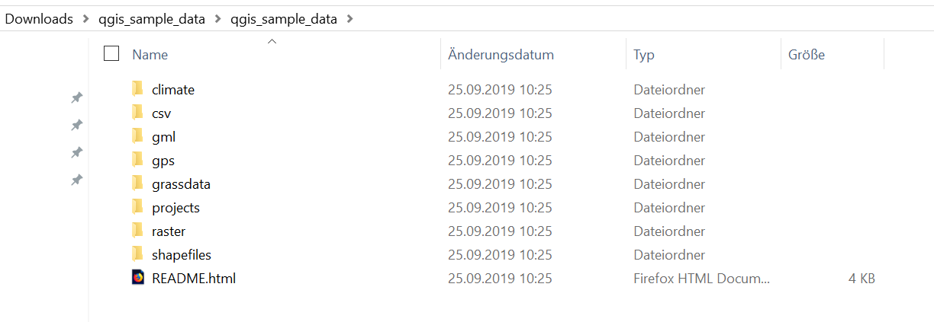
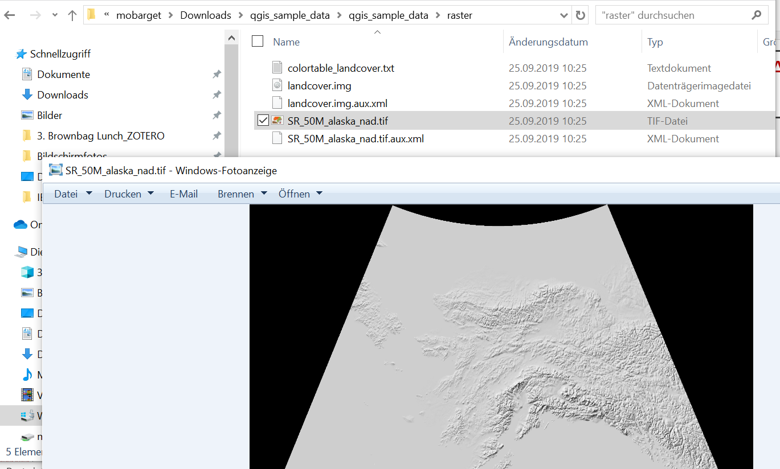
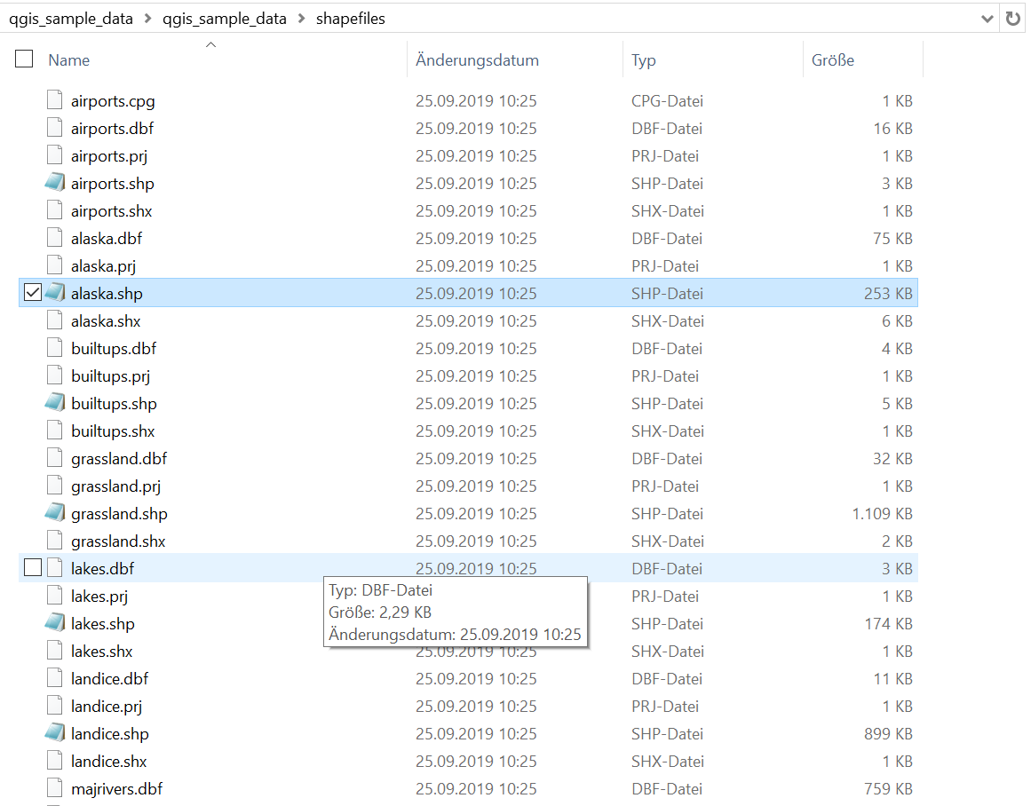
HOW GIS DATA ARE STRUCTURED AND STORED

Slide 4
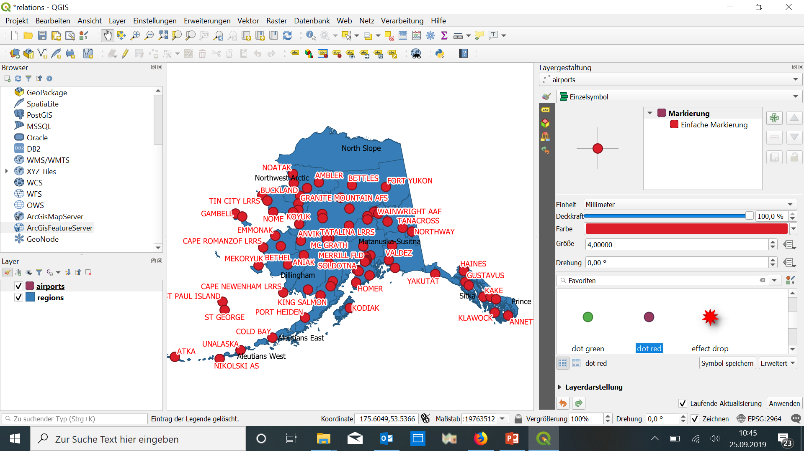
Displaying and Adjusting GEODATA in QGIS: e.g. map of Annette Island
Annette Island or Taak'w Aan (Tlingit), part of the Gravina Islands in the Alexander Archipelago of the Pacific Ocean, Alaska, United States of America
Link to sample data: https://qgis.org/downloads/data/

Slide 5
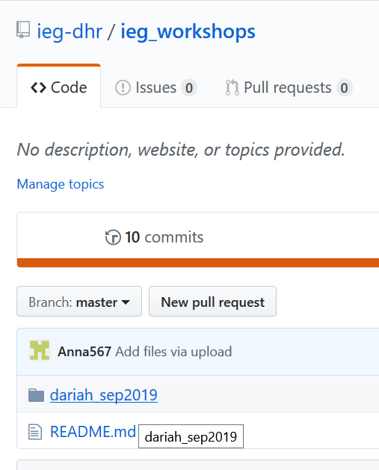
GETTING STARTED WITH OUR HANDS-ON SESSION
IEG Digital Historial Research on GITHUB: https://github.com/ieg-dhr/

Slide 6
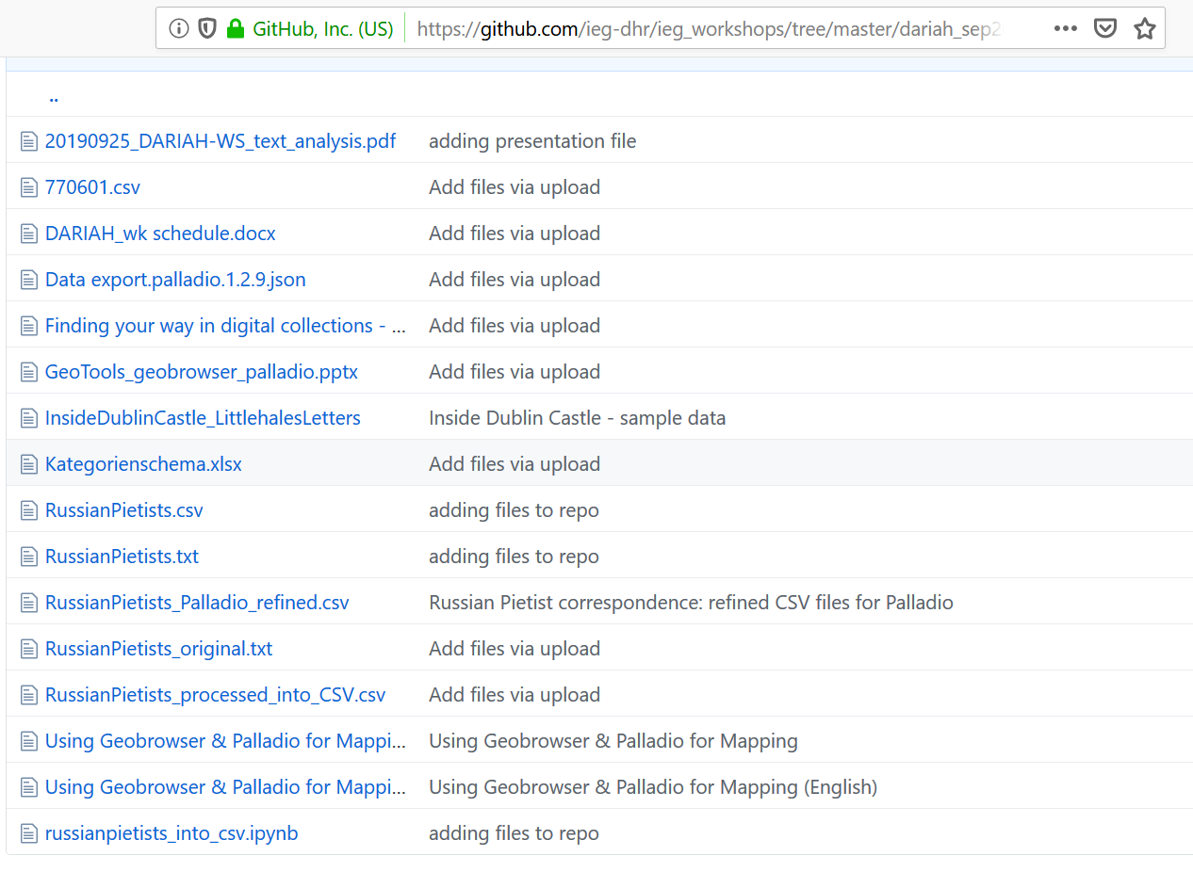
Understanding our Sample Data
Samples: all files relating to the German Pietist community in Russia
Data were first stored in .TXT format and converted to different .CSV files later
Introductions to Geobrowser and Palladio are provided in German and English („Using …“ PPTs)

